Slide 1
Introduction to Agile Development
Mark Micallef

Slide 2
Problems with modern development
Unclear requirements
Fluctuating requirements
Quality problems with software
Working in teams is difficult
Difficulties with project momentum
Difficulties with visibility
Difficulties with managing the customer

Slide 3
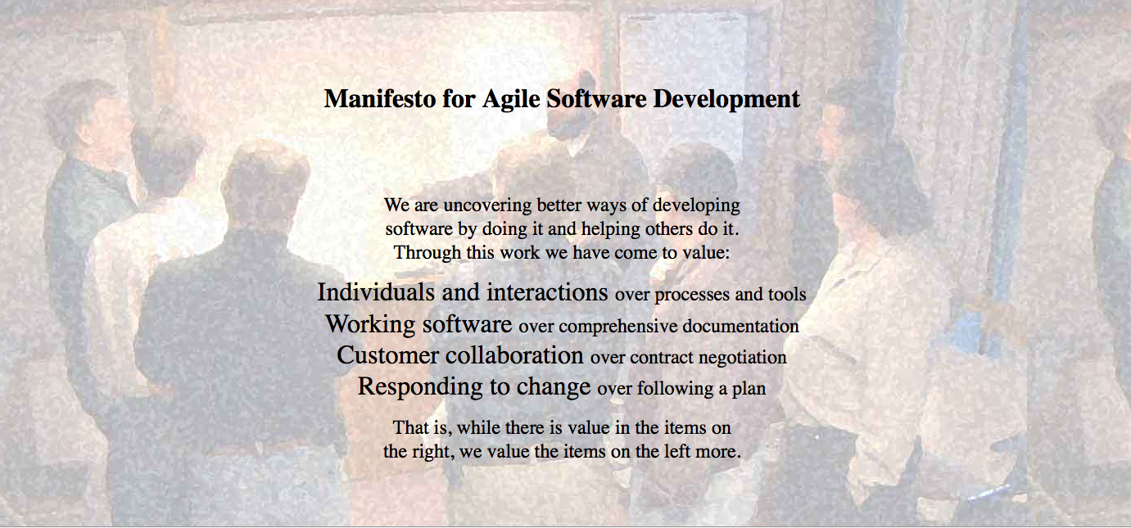

Slide 4
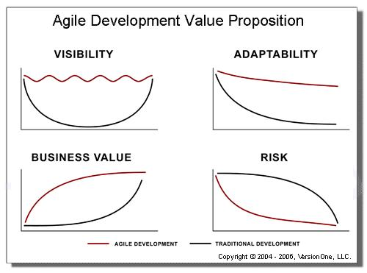
§

Slide 5
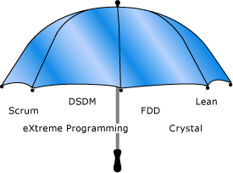
Agile as an umbrella

Slide 6
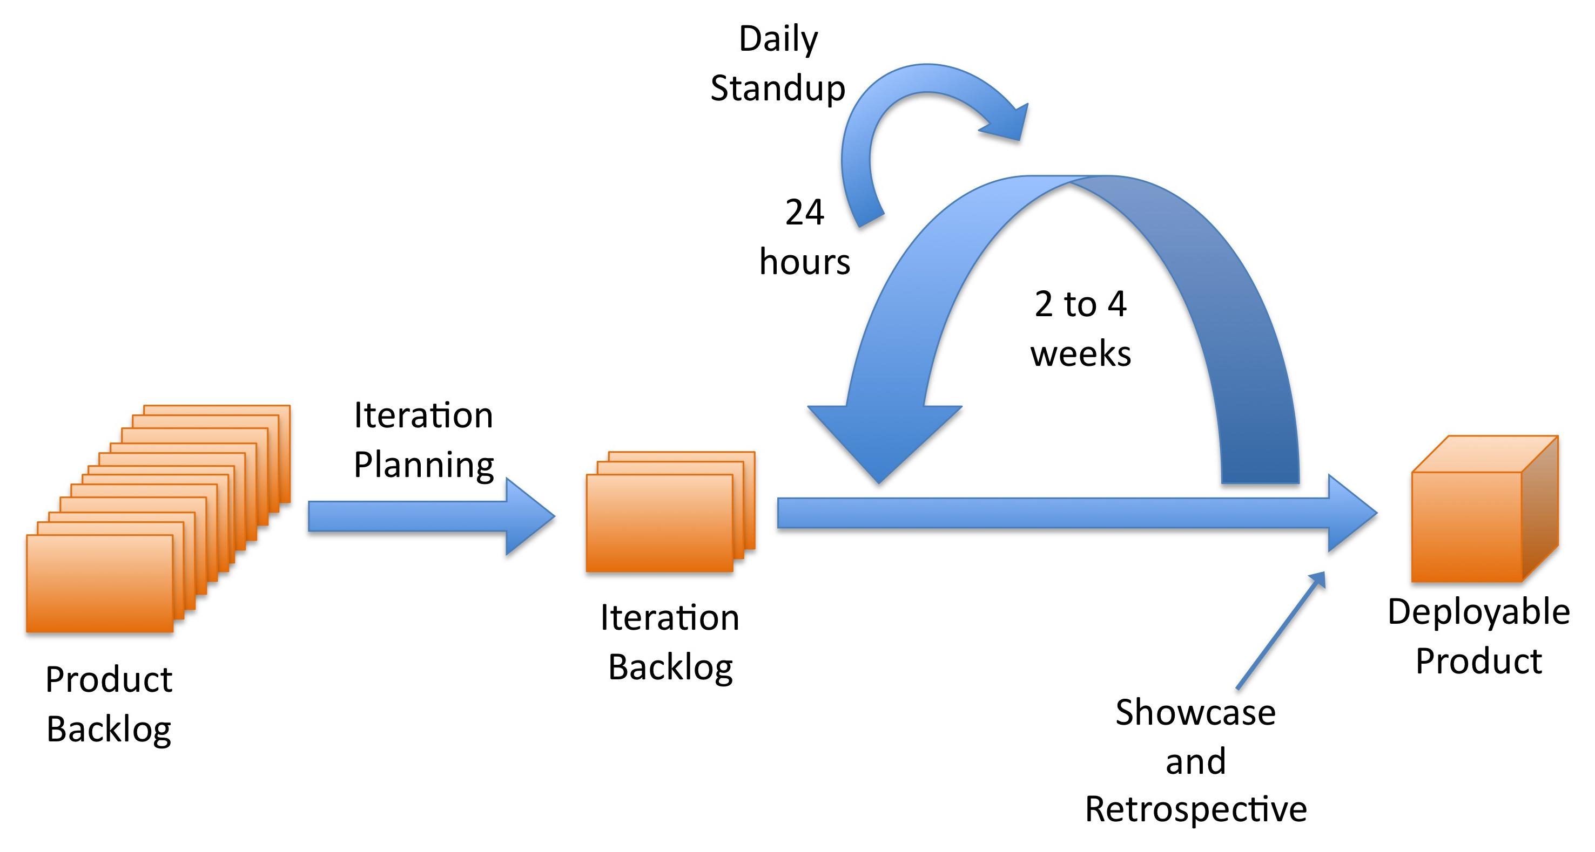
A Typical Agile Process

Slide 7
Maintaining the flow of delivery
Timebox approach
Ideally 1 to 3 week iterations.
Longer iterations possible but feedback benefits start to decrease
Prioritisation (MoSCoW urules)
Must have, Should have, Could have, Want be nice have
User and stakeholder agreement
Power of decision

Slide 8
Iterations
Iteration 1
Code
Test
Deploy
Feedback
Code
Test
Deploy
Iteration 2
Feedback
Iteration 3
Code
Test
Deploy

Slide 9
A closer look at an iteration
Retrospective (n-1)
Showcase (n-1)
Iteration Planning (n)
9 | 10
Retrospective (n)
Iteration n-1
Showcase (n)
Iteration Planning (n+1)
1 | 2 | 3 | 4 | 5 | 6 | 7 | 8 | 9 | 10
Iteration n
Daily Standup Meetings
Regular development work

Slide 10
Iteration Zero
Agree on process parameters
Carry out any necessary spikes
Set up necessary infrastructure
Source Control and Continuous Integration
Bug tracking
Wikis
Team Walls
Anything else you might need
Hold a product inception meeting

Slide 11
User Stories
The predominant form of requirements in agile
Specified by the product owner
Reviewed and negotiated by the team
Each story must have acceptance criteria

Slide 12
User Story Example
In order to allow users to see my products,
As an online merchant,
I want to be able to add products to my store
Who uses this feature?
Focus on value
```````
What does the feature enable the user to do?

Slide 13
Acceptance Criteria
Given I am an online merchant
When I add a product to the store
Then I should see it in the product catalogue
Given I am an online merchant
When I add a product to the store
And I associate a photo with the product
Then I should see the the product in the catalogue
And the photo will be displayed next to the product

Slide 14
Characteristics of good user stories
Clear and concise
Traceable
Testable
Complete
Consistent
Necessary
Implementation free
Viable

Slide 15
Life Cycle of a User Story
Conversation
Test Cases
Software
Idea

Slide 16
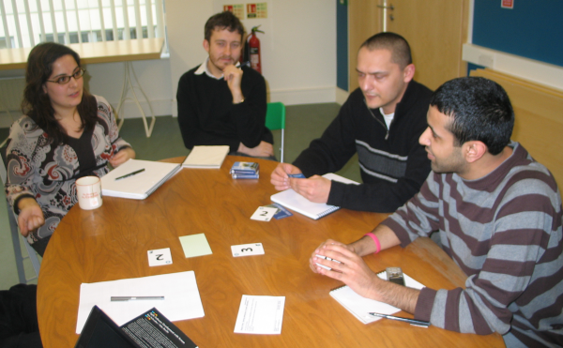
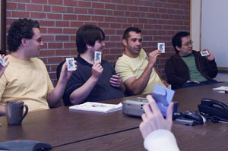
Iteration Planning
Client prioritises user stories
Team estimates the size of user stories
Iteration backlog is created

Slide 17
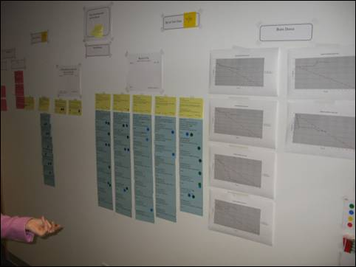
The Team Wall

Slide 18
Providing Visibility
Velocity
Bug Counts
Defect Arrival Patterns
Burndown and Burnup Charts

Slide 19
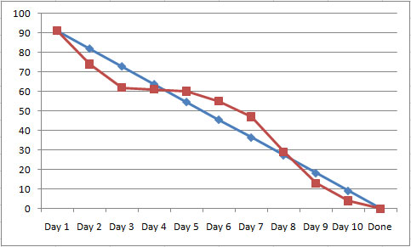
Burndown Chart

Slide 20
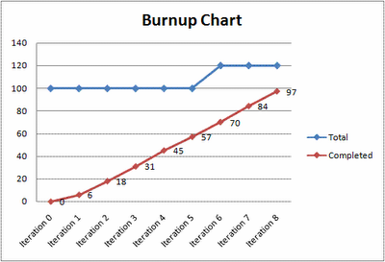
Burnup Charts

Slide 21
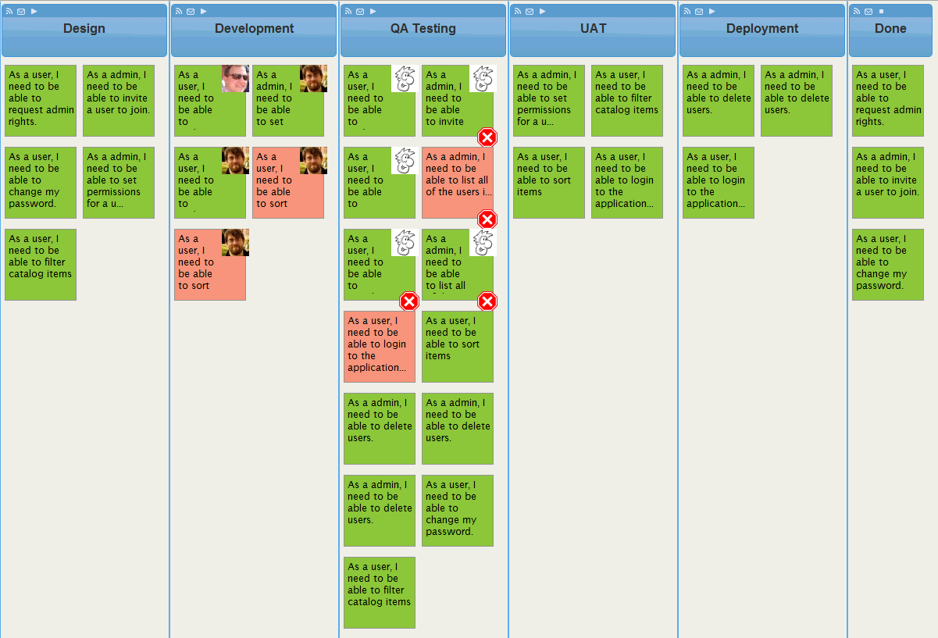
The Team Board

Slide 22
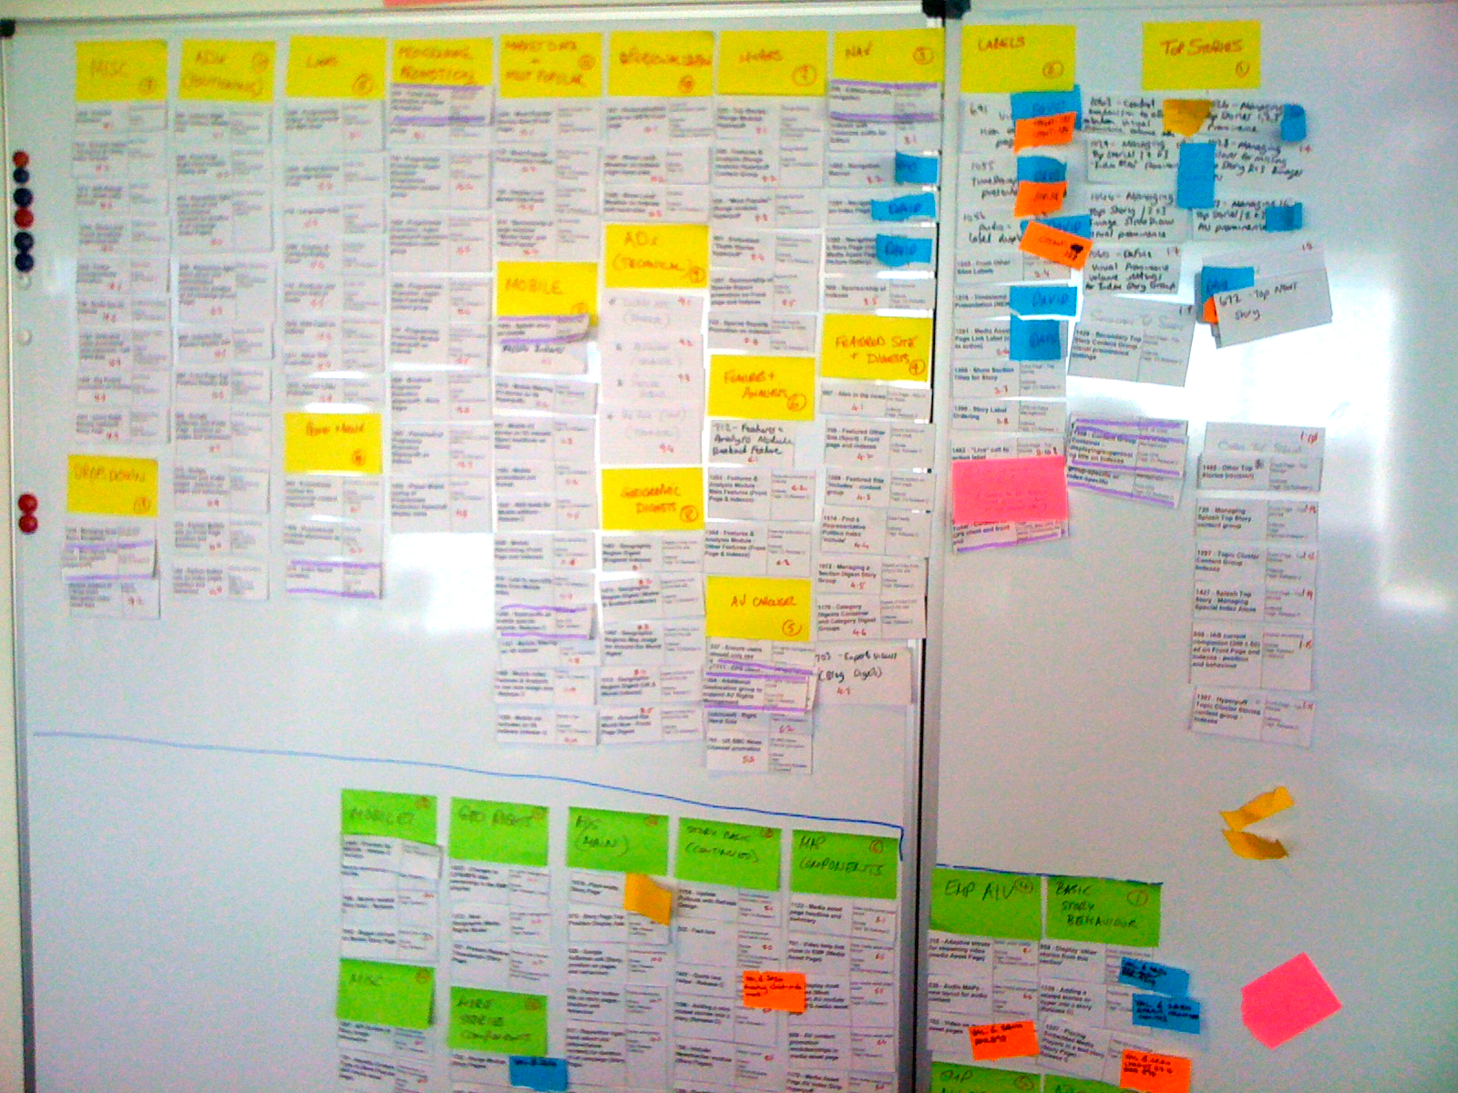
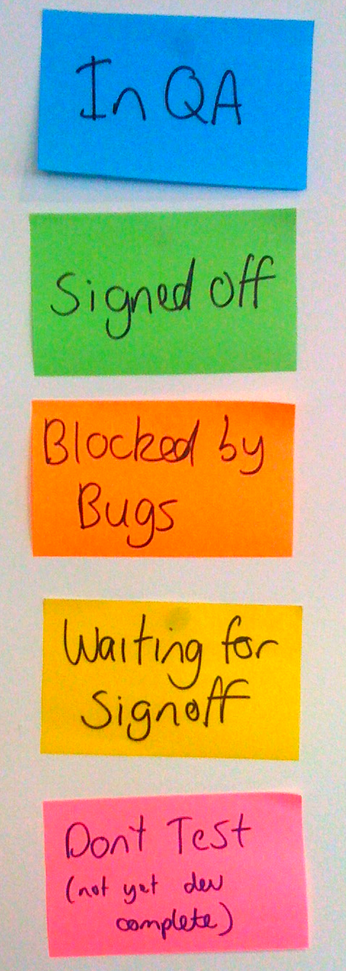

Slide 23
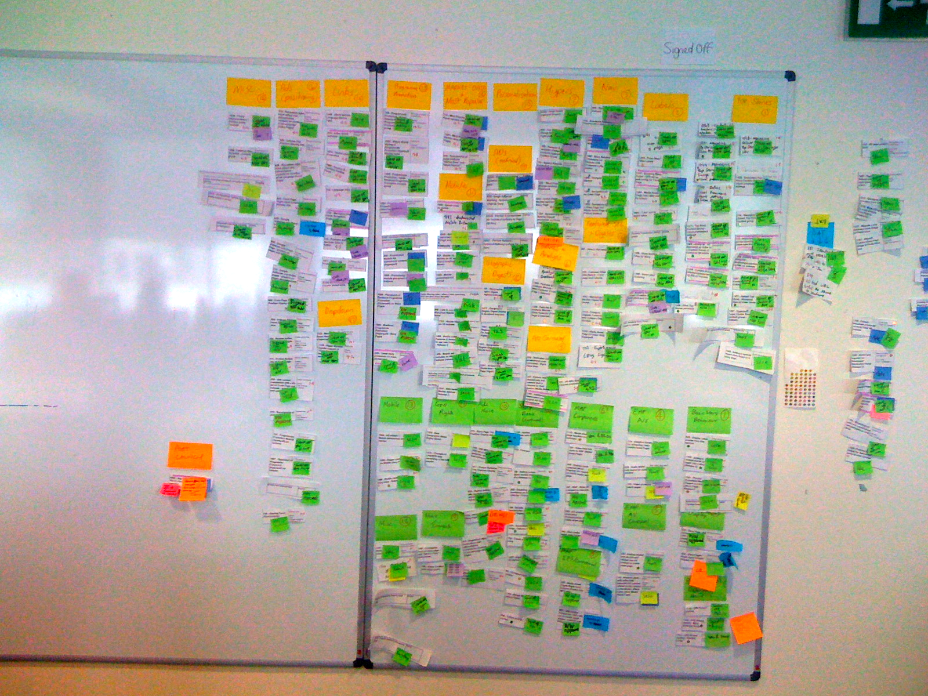

Slide 24
Daily Standup Meeting
Short meeting (5 – 10 mins)
Aimed at communicating status and surfacing problems
Everyone answers 3 questions:
What did I do yesterday?
What will I do today?
What’s in my way?
For the team, by the team
Why meet standing up?

Slide 25
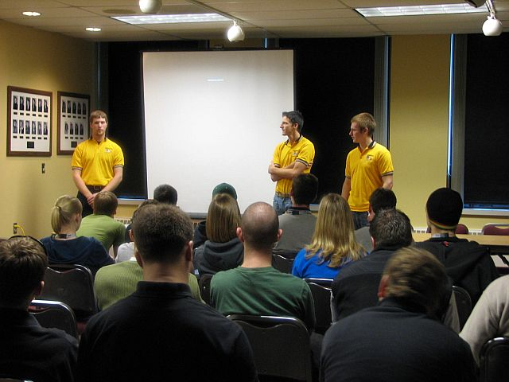
Showcase

Slide 26
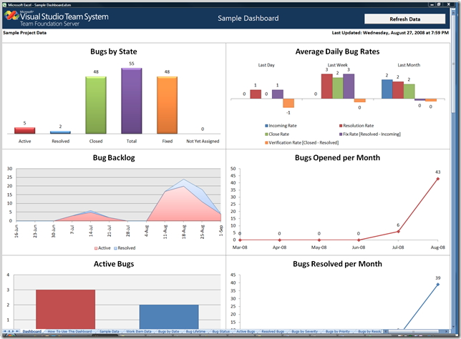
Showcase

Slide 27
Retrospective
Gives you ownership of the process
Looks at:
What went well?
What did not go as well as hoped?
New ideas for improvement
Should result in a list of actions

Slide 28
Team Values
Respect the worth of every person
Truth in every communication
Transparency of all data, actions and decisions
Trust that each person will support the team
Commitment to the team and its goals

